Slide 1
PART I:
ENERGY IN THE ATMOSPHERE

Slide 2
Lecture Outline
Air Pressure & Density
Energy
  Definitions, examples, laws
Temperature
  Definition, examples, measurement
Heat
  Definition, mechanisms of transfer
Water
  Evaporation/condensation
Atmosphere
  definition, evolution, layers

Slide 3
AIR PRESSURE
Pressure = Force/Area
  a ‘pushing’ action
Air is constantly ‘pushing down’ on us
  That weight is called Air Pressure.
The higher you go there is less air to ‘push down’.

Slide 4
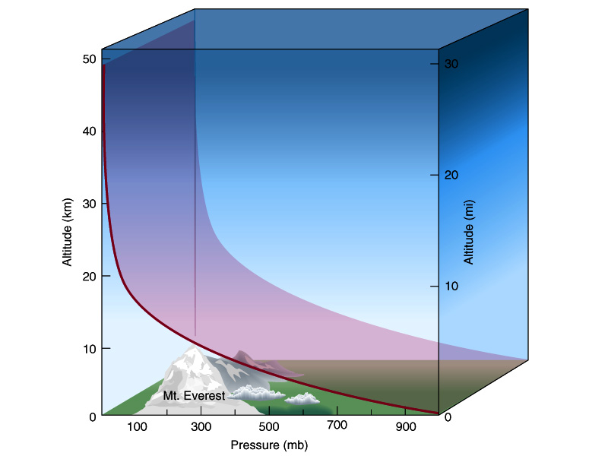
Pressure & Density

Slide 5

AIR PRESSURE
In the US, Pressure is measured in Millibars or mb
  Most of the world measures Pressure in Pascals (Pa)
    1mb = 100 Pa
Air pressure at sea level averages 1013.2 mb

Slide 6
Air Density
Density
  A Measure Of Mass Per Unit Of Volume.
    Mass/Volume.
      kilogram per cubic meter (kg/m3)

Slide 7
Air Density
Density (Cont.)
  Gasses are compressible:
    No Limit to the amount of mass per volume
      As you add/subtract mass, density will increase/decrease
    However, a volume containing a fixed mass can be COMPRESSED, resulting in density increase.

Slide 8
Air Density
Air Is More Dense At Lower Altitudes Than That At Higher Altitudes
  The lower the altitude, the greater the mass of air directly above
    This creates downward pressure and compression
  99% of air molecules are within 30km of the surface
    Held there by Gravity

Slide 9
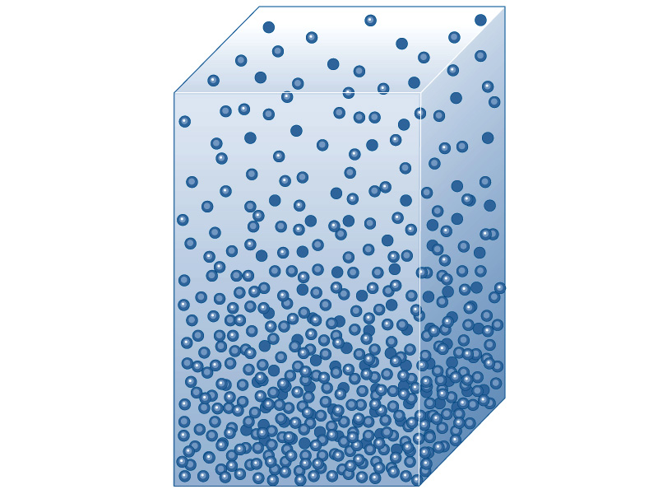
Fig. 1-8, p. 14

Slide 10
PRESSURE & DENSITY
Density is directly related to Pressure
Both Pressure and Density DECREASE with increasing elevation, and vice versa…
Pressure changes faster lower in atmosphere because density is higher

Slide 11
Pressure & Density

Slide 12
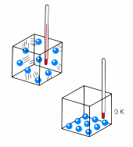
Temperature Is…
A Measure Of The Average Speed Of Motion Of Atoms & Molecules
  Of Their Average Kinetic Energy.
  Higher Temp Indicates Faster Motion

Slide 13
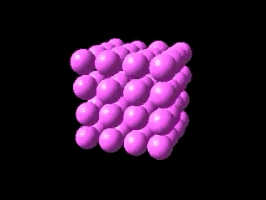
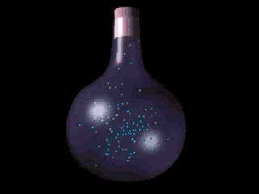
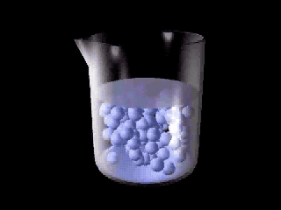

Slide 14
Hot Air
As Air Is Heated, Its Molecules Move Faster & Further Apart
  so air expands, and it takes up more volume…
  thus it is less dense than surrounding cooler air, and it rises (ascends).

Slide 15
Cold Air
As Air Is Cooled, Its Molecules Move More Slowly And Closer Together
  so air contracts, and it takes up LESS volume…
  thus it is MORE dense than the surrounding warmer air, and it sinks (descends)

Slide 16
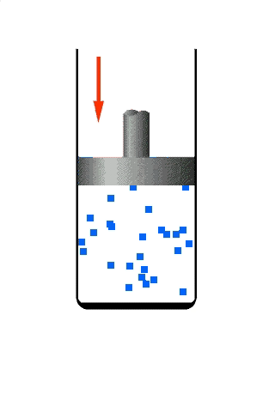

Slide 17
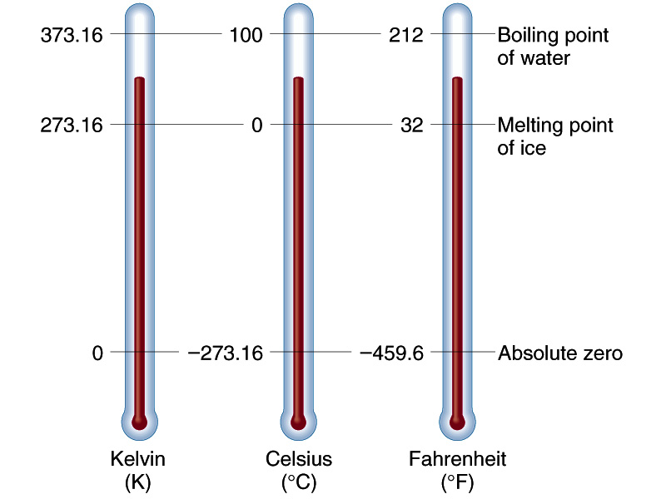
Measuring Temperature
ABSOLUTE ZERO – lowest possible temp,
0 K (-273 °C)

Slide 18
What Is Energy?
The Ability Or Capacity To Do Work
  The Potential For Causing Change
  An agent capable of:
    Setting an object in motion
    Warming a Teapot
    Pushing
    Pulling
    Lifting
    Etc.

Slide 19
2 General Categories of Energy
Potential & Kinetic
  Potential Energy
    Energy That Is Stored
    Energy That Is "Captured" In An Object, With The Potential To Be Released
    Energy Given To An Object By Its ‘Positioning’

Slide 20
2 General Categories of Energy
Potential & Kinetic (Cont.)
  Kinetic Energy
    ‘The Energy Of Motion’
    The Energy That A Body Possesses As A Result Of Its Motion
      Faster Movement = More Energy
      Greater Mass = More Energy
        (Rest Energy)

Slide 21
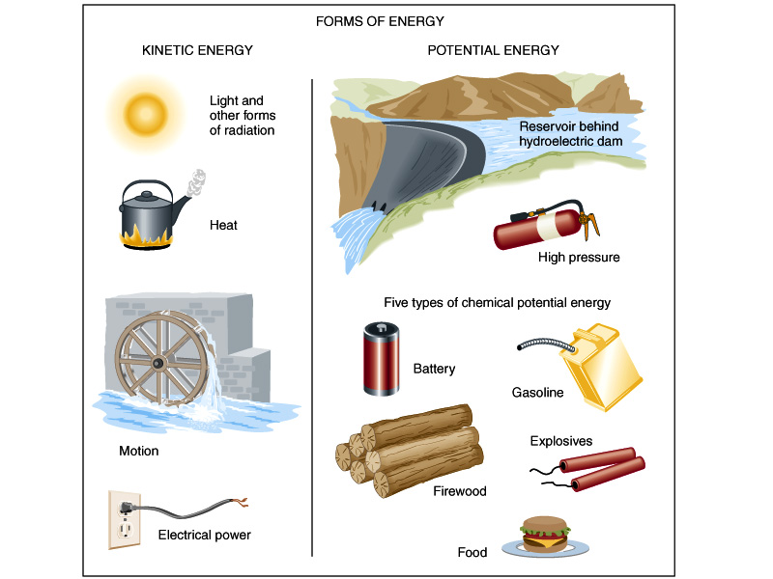
Fig. 2-1

Slide 22
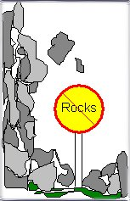
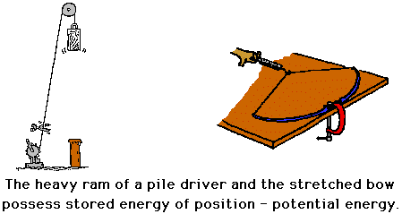
Potential Energy
Of Positioning

Slide 23
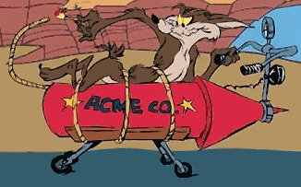


Slide 24
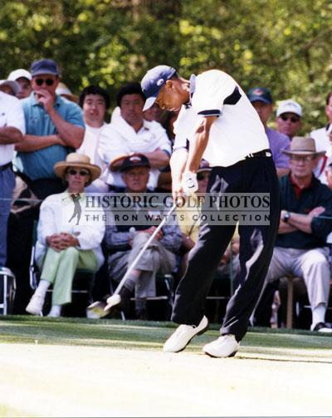
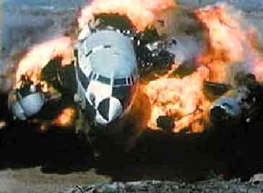
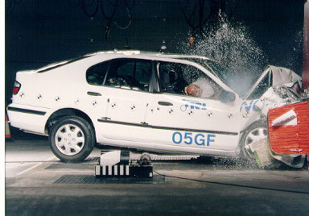
Kinetic Energy

Slide 25
First Law Of Thermodynamics
Conservation of Energy
  Energy Cannot Be Created Nor Destroyed
    it can only change/transfer from one form to another

Slide 26
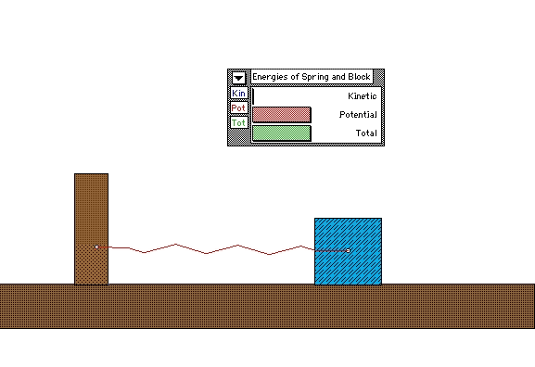

Slide 27
Heat Is…
Energy In The Process Of Being Transferred From One Object To Another.
  Usually moves from hotter to cooler.

Slide 28
Mechanisms Of Energy Transfer
Conduction
  Transfer of Heat from one molecule to the next through a substance.
    Molecules must be touching one another.
    Molecules do NOT move.

Slide 29
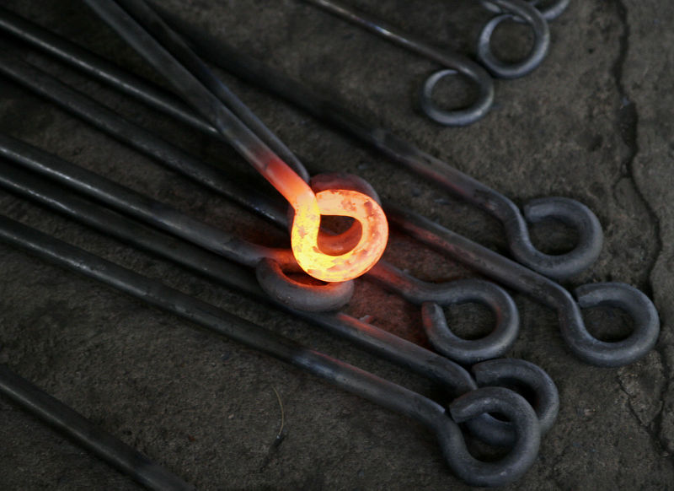

Slide 30
Mechanisms Of Energy Transfer
Convection
  Transfer of Heat by the mixing of a fluid (liquid or gas).
    Molecules move
  Transfer occurs by the movement of hot or cold portions of the fluid

Slide 31
Mechanisms Of Energy Transfer
Convection (Cont.)
  Boiling Pot of Water:
    Hot water from the bottom of the pan rises as it expands and becomes less dense. The rising water is then replaced by cooler, denser, water from above
  Vertical transfer of heat through the atmosphere…
    e.g. Thermals

Slide 32
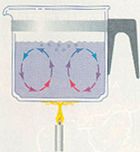
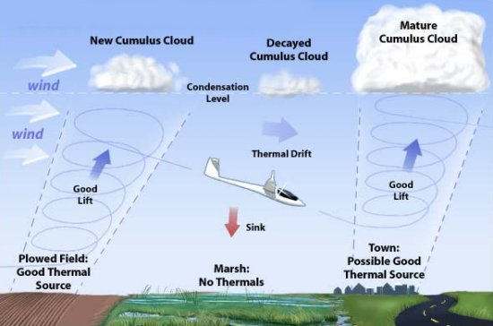
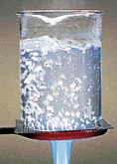
Upward Movement of Air Leads
to Low Pressure at Surface
When air hits top of atmosphere it has to
go somewhere, so it spreads out leaving less
air thus less weight (pressure) pushing down
Notes:
Upward movement of air leads to low pressure at surface since air diverges at top of atmosphere leaving less mass thus less pressure

Slide 33
Mechanisms Of Energy Transfer
Advection
  Horizontal transfer of heat energy by wind
    Heat is not moving independently, but is blown.
  Can also refer to the horizontal transfer of any property of the atmosphere.

Slide 34
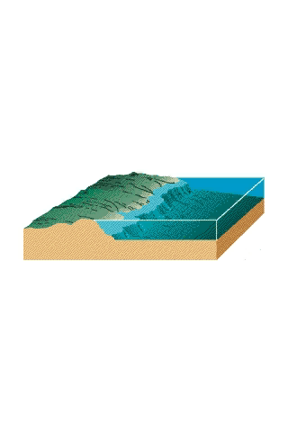

Slide 35
Mechanisms Of Energy Transfer
Electromagnetic Radiation
  Transfer by oscillations in an electric field and a magnetic field (EM)
    No special medium required.
    Only Transfer Mechanism that can occur through the vacuum of empty space
  Method by which ALL of the Earth’s Energy is obtained!

Slide 36
Mechanisms Of Energy Transfer
Electromagnetic Radiation (Cont.)
  EM Radiation is emitted by ALL matter
    It can take different forms (Visible, Infrared, Microwave, etc.) each with its own wavelength.
    Wavelength is measured from short to long, in micrometers (µm).
  The EM Spectrum is the full range of EM radiation

Slide 37
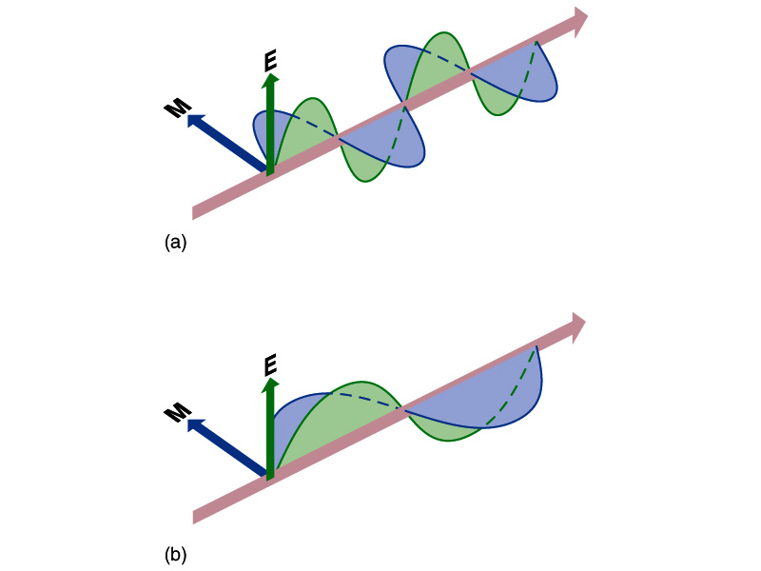
Fig. 2.5, p.35

Slide 38
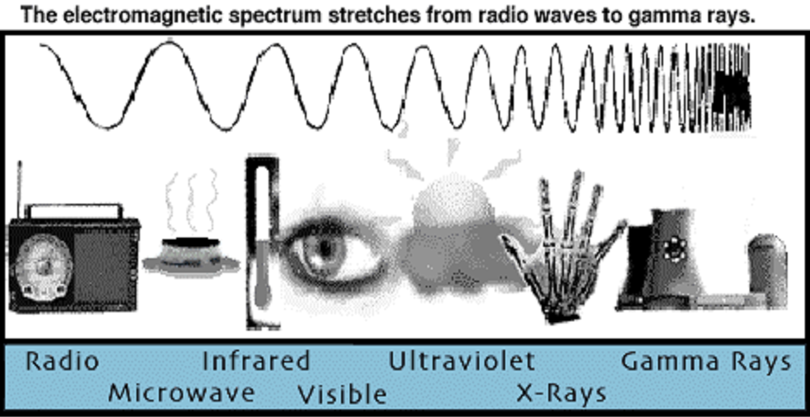

Slide 39
Mechanisms Of Energy Transfer
Two laws describe the intensity and type of wavelengths that are emitted/radiated from different objects:
  Stefan-Boltzman Law
  Wien’s Law

Slide 40
Stefan-Boltzman Law:
A Hotter Body Emits More Energy Than A Cooler Body
If the body is 2X as hot, it will emit 16X as much energy
  I = constant T⁴
      I = Intensity of radiation
      T = Temperature of body in Kelvins
      Constant = 5.67x10-8 Wm-2
      T_{earth} ~ 300 K T_{sun} ~ 6000 K

Slide 41
Wien’s Law:
Hotter Bodies Radiate Energy At Shorter Wavelengths
Wavelength of max emission = Constant/T
    T = Temperature of body in Kelvins
    Constant = 2900

Slide 42
Wien’s & Stefan-Boltzman Laws
Together, Indicate That
  A Very Hot Body Will Emit Lots Of Energy At Very Short Wavelengths
    e.g. The Sun
  A Very Cool Body Will Emit Less Energy At Much Longer Wavelengths
    e.g. The Earth

Slide 43
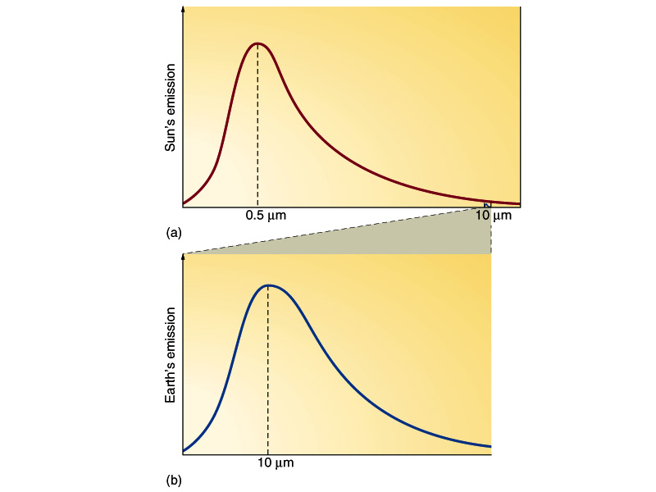
Fig. 2.7, p.37

Slide 44
WATER in the Atmosphere
Water content varies enormously, but always relatively low…
  Up to 4% in the Tropics
  As low as a fraction of 1% in the Polar regions and deserts
    Very important to our general level of comfort

Slide 45
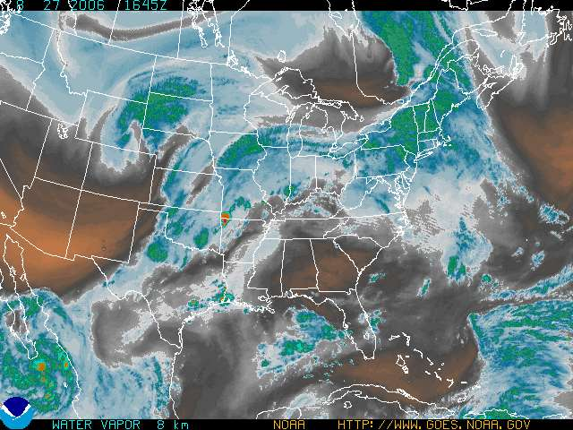

Slide 46
WATER in the Atmosphere
Water exists in 3 states
  Solid, Liquid & Vapor (Gas)
    Generally, the water in our atmosphere takes the form of vapor
  When Water Molecules Change State
    They Absorb Or Release LATENT HEAT ENERGY
      An important way to exchange energy in the atmosphere

Slide 47
WATER in the Atmosphere
Evaporation
  Is A Cooling Process
  Requires an input of energy to change state.
    This input of energy can come from the water or other sources.
      Energy is needed to break bonds holding liquid together
      Known as Latent Heat of Evaporation

Slide 48
WATER in the Atmosphere
Condensation
  Is A Warming Process
  Latent Heat is released to the environment as vapor condenses.
    Known as Latent Heat of Condensation

Slide 49
Recall That Temp is…
The Average Speed Of the Motion Of Atoms & Molecules
Notes:
Liquid and vapor at same T have same kinetic energy, but liquid has bonds which reduce the potential energy. Breaking a bond requires energy input, forming bond releases energy. Bonded particles are stable compared to free particles. They would be at the bottom of the hill, breaking their bond would be like bringing them to top of the hill. LIQUID HAS LESS POTENTIAL ENERGY THAN VAPOR. Two freely moving particles are going to have more energy than two bonded particles even if both situations have same kinetic energy ie Temperature.

Slide 51
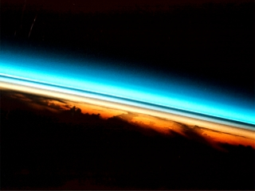
Shuttle Image of Earth Atmosphere

Slide 52
What Is The Atmosphere?
A Thin Gaseous Envelope Surrounding The Earth, Held By Gravitational Attraction.
  Unique in our solar system!
  99% is within 30 km of the earth’s surface.
    The remainder is within about 500km

Slide 53
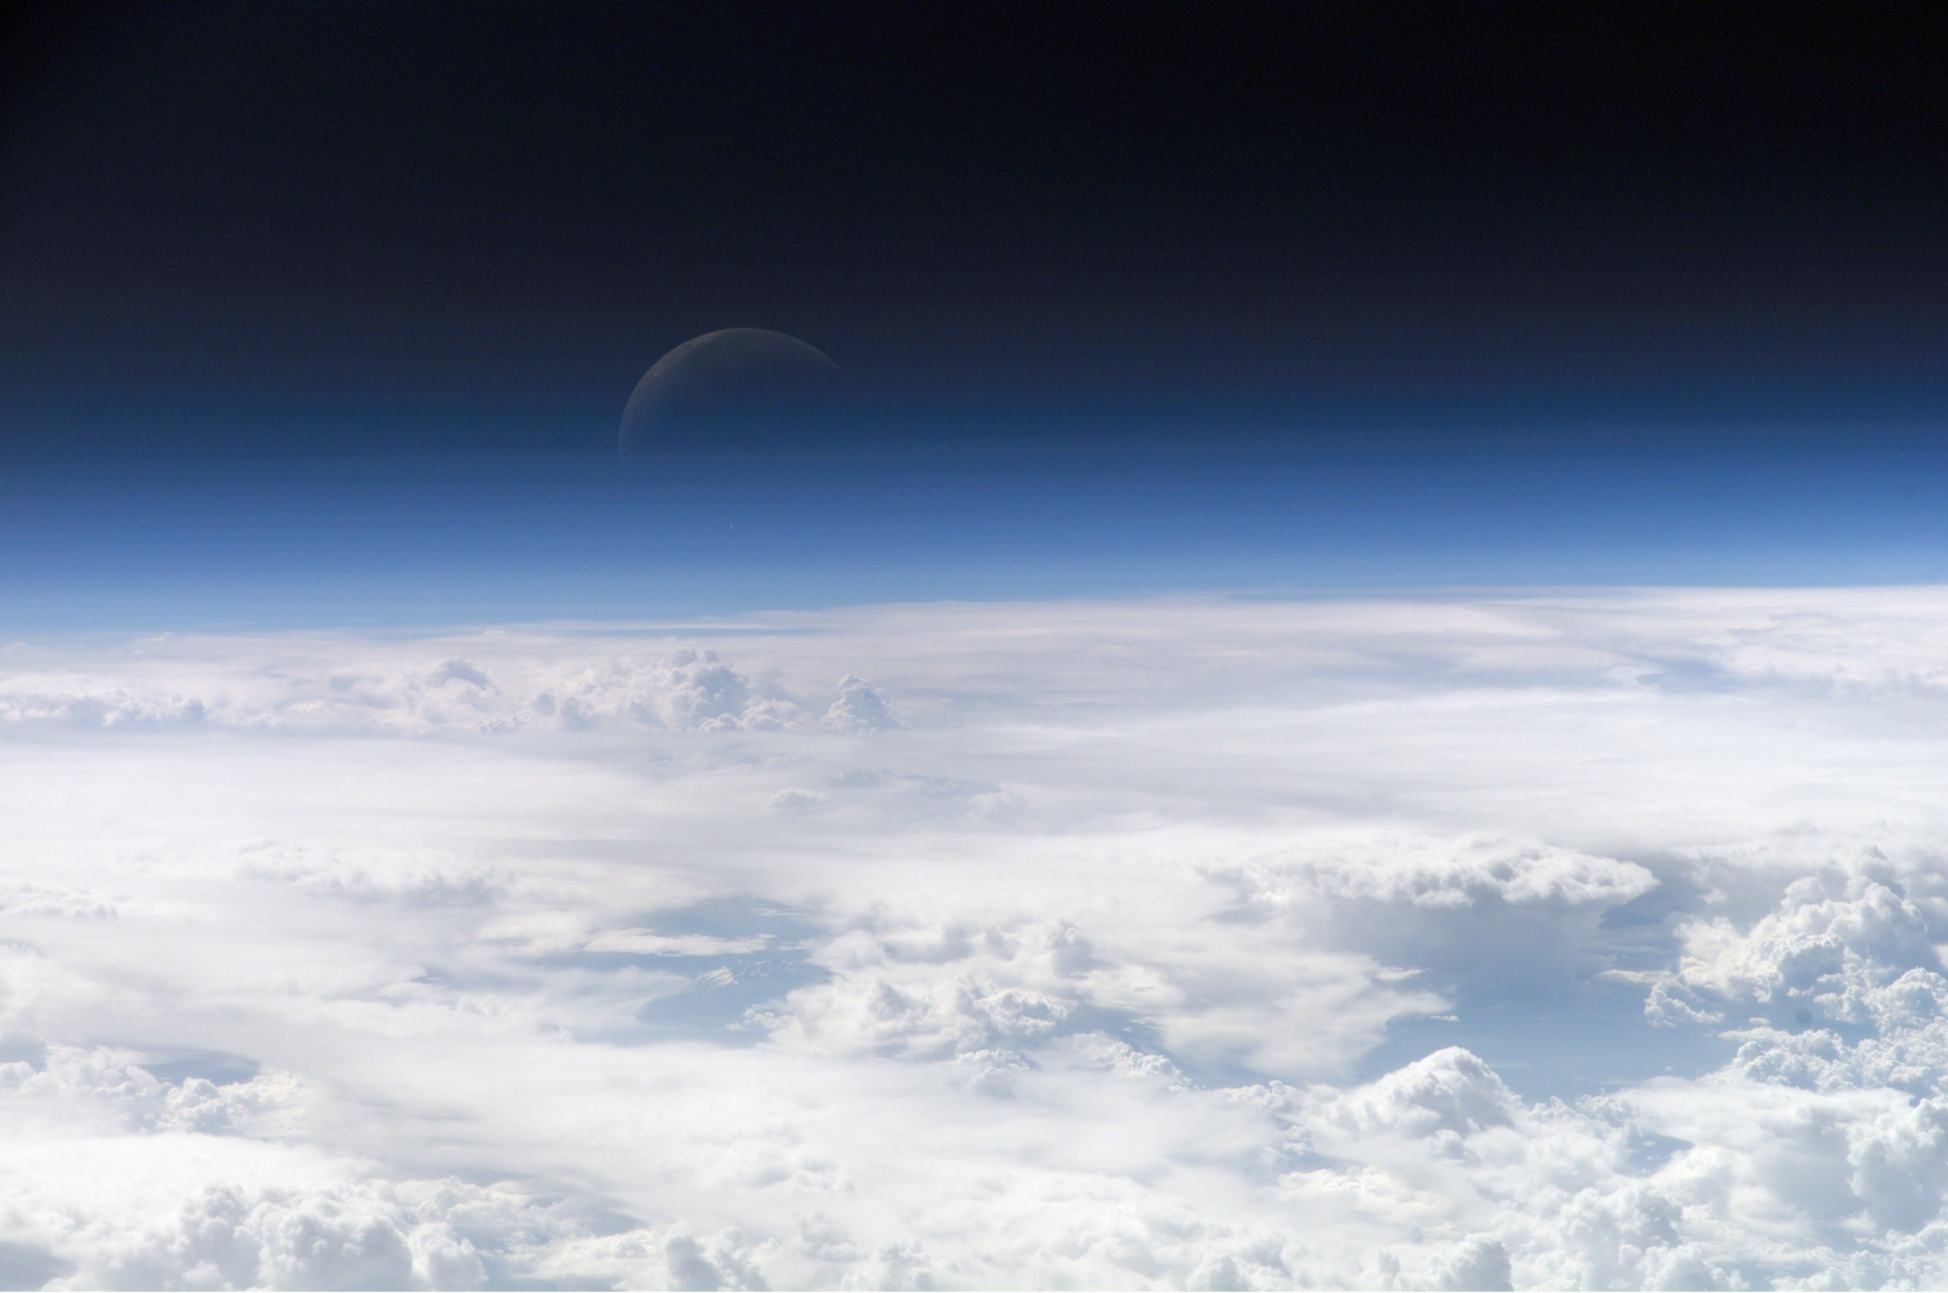
VERY THIN compared with earth’s volume...
Earth’s Diameter = 13,000km or 8,000mi

Slide 54
Evolution Of The Atmosphere
The Earth is approx. 4.5 billion years old
  Atmosphere evolved through time…
The FIRST Atmosphere was mostly composed of hydrogen & helium
  these were lost to space…

Slide 55
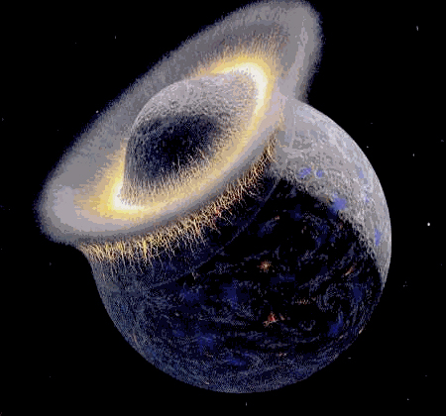
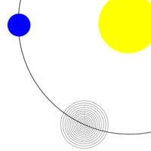

Slide 56
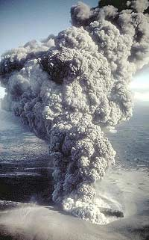
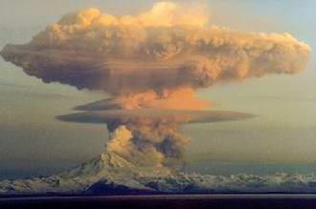
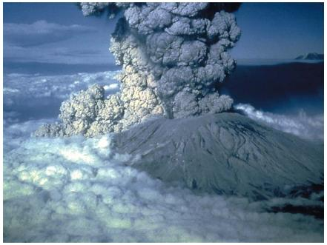
The SECOND Atmosphere was composed of the gas by-products of volcanic eruptions
  water vapor, carbon dioxide, nitrogen, sulfur, etc.

Slide 57
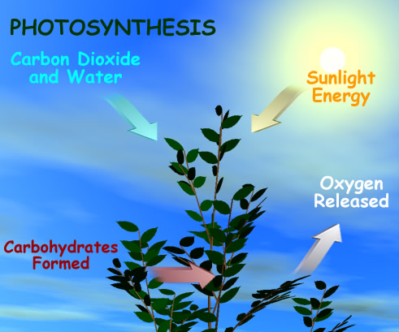
Evolution Of The Atmosphere
The MODERN Atmosphere is approx. 600 million years old.
  Created through PHOTOSYNTHESIS of Carbon Dioxide by GREEN plants forming Oxygen.
    Since earliest green plants,
      Oxygen content has risen until stabilized at 21% of the atmosphere.
    Nitrogen accounts for the vast majority of the remaining atmosphere at 78%

Slide 58
What Is The Atmosphere?
Divided Into ‘Spheres’ According To Properties Of
  Composition
  Temperature
  Function
    Each _sphere is separated by a _pause
      Marks changes in atmospheric characteristics

Slide 59
Atmospheric Composition
Two Distinct Chemical Layers:
  Homosphere
  Heterosphere

Slide 60
Atmospheric Composition
Homosphere
  Atmosphere's lower 50mi/80km
  The mixture of various gases are almost constant throughout
  Colorless, formless, & tasteless
    so well mixed that gases act as single entity
      78% Nitrogen
      21% Oxygen
      Trace gases, carbon dioxide, water vapor & inert gases.

Slide 61
Atmospheric Composition
Heterosphere
  Mixture of various gases varies with altitude
  Gases arranged in layers according to atomic weight
  Heaviest gases toward bottom, lightest gases (hydrogen!) on the top

Slide 62
Constituent | Formula | Percent by Volume | Permanent/Variable
Nitrogen | N₂ | 78.08000 | Permanent
Oxygen | O₂ | 20.95000 | Permanent
Argon | Ar | 0.93000 | Permanent
Water Vapor | H₂O | 0.25000 | Variable
Carbon Dioxide | CO₂ | 0.03800 | Variable
Ozone | O₃ | 0.01000 | Variable
Neon | Ne | 0.00200 | Permanent
Helium | He | 0.00050 | Permanent
Krypton | Kr | 0.00010 | Permanent
Xenon | Xe | 0.00009 | Permanent
Hydrogen | H₂ | 0.00005 | Variable

Slide 63
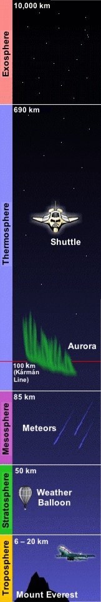
Atmospheric Composition
Four Distinct Temperature Layers:
  TROPOSPHERE
  STRATOSPHERE
  MESOSPHERE
  THERMOSPHERE

Slide 64
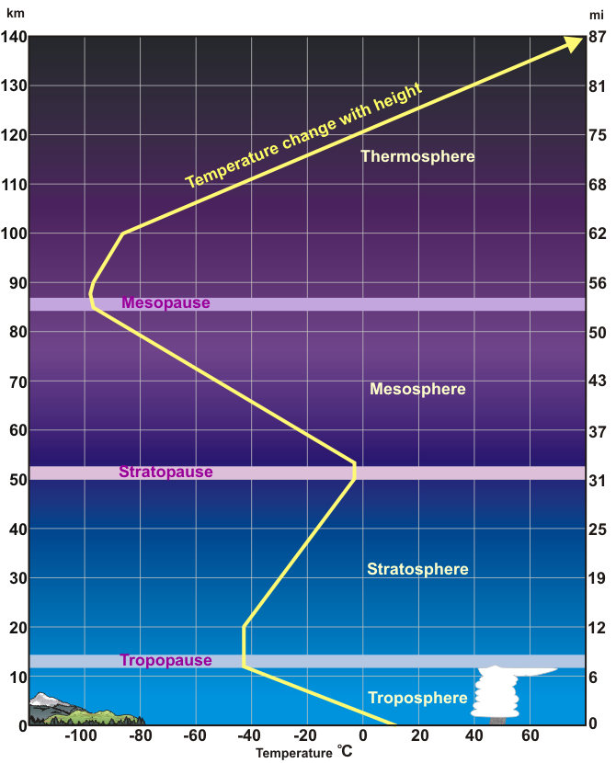
Atmospheric
Composition
TROPOSPHERE
  Begins at the Earth's surface and extends to Tropopause
    Transition boundary between the troposphere and the layer above
    Avg. elevation of TROPOPAUSE is 11km
      is higher over the equator than over the poles.

Slide 65
Atmospheric
Composition
TROPOSPHERE (Cont.)
  Temperature DECREASES with increasing elevation
    62°F (17°C) to -60°F (-51°C)
    Reason: air is heated by energy from surface…
  Almost all weather occurs in this region.
  Troposphere and the Tropopause are collectively known as the lower atmosphere.

Slide 66
Atmospheric
Composition
STRATOSPHERE
  Extends from the Tropopause up to 31 miles above the Earth's surface.
    This layer holds 19 percent of the atmosphere's gases but very little water vapor.
  Stratopause
    Transitional boundary which separates the stratosphere from the mesosphere
    Avg. elevation of 50km

Slide 67
Atmospheric
Composition
STRATOSPHERE (Cont.)
  Temp INCREASES with increasing elevation
    From approx. -76°F (-60°C) to approx. 5°F (-15°C) at Stratopause
    ‘Not normal’ -- called an INVERSION
      temp decrease is upside down
    Reason: ozone is present
      it absorbs ultra violet solar energy from the sun, & thus heats up stratosphere.

Slide 68
Atmospheric
Composition
MESOSPHERE
  Extends from the Stratopause to Mesopause about 53 miles (85 km) above the earth.
  Temp DECREASES with increasing elevation
    From approx. 5°F (-15°C) to approx. -184°F (-120°C) at the Mesopause.

Slide 69
Atmospheric
Composition
MESOSPHERE (Cont.)
  gases in the mesosphere are thin, but thick enough to slow down meteorites entering into the atmosphere
    where they burn up, leaving fiery trails in the night sky.
  Stratosphere, Stratopause, Mesosphere & Mesopause are collectively called the middle atmosphere.

Slide 70
Atmospheric
Composition
Kármán line
THERMOSPHERE
  Extends from Mesopause to Thermopause
    Approx. 430 miles (690 km) above the earth.
  This layer is known as the upper atmosphere.
  Greater proximity to sun
    Molecules in thermosphere absorb high frequency solar energy first.
US: Astronauts
Notes:
The thermosphere absorbs the high energy photons from the sun because they come in contact with thermosphere first.

Slide 71
Atmospheric
Composition
THERMOSPHERE
  Temp INCREASES with increasing elevation
    As high as 3,600°F (2000°C) near the top of this layer.
      Small # of molecules moving EXTREMELY fast!!!
    However, this not sensible heat.
      Would still feel very cold to our skin.
      Too few molecules to warm skin
  The few attracted gas molecules above the Thermopause are in the EXOSPHERE

Slide 72
Atmospheric Composition
Functional Layers
  Ozone Layer
  Ionosphere
Ozone layer
  Exists Throughout Stratosphere, Making It Warm
    Ozone (0₃) is formed by the combination of atomic oxygen (O) and molecular oxygen (0₂)

Slide 73
Atmospheric Composition
Ozone layer (Cont.)
  Ozone
    Near the earth’s surface ozone is an air pollutant acting as an irritant to lungs and eyes and damaging vegetation.
    However, in the upper atmosphere ozone (the ozone layer)…
  Protects The Earth From Ultra Violet Light
    Ozone absorbs UV and is split back into atomic oxygen (O) and molecular oxygen (0₂)

Slide 74
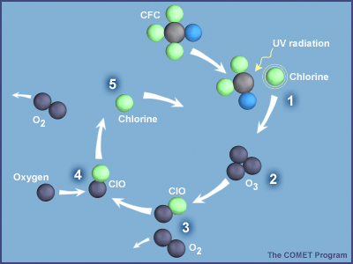
  Human Activities Caused Thinning, Especially At High Latitudes (Ozone Hole)
  A single Chlorine atom can destroy 100,000 ozone molecules

Slide 75
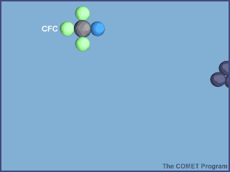
  Montreal Protocol of 1987:
      Developed countries agreed to Ban production of CFCs
      Decreases in the size of the Ozone ‘hole’ expected between 2015 & 2045

Slide 76
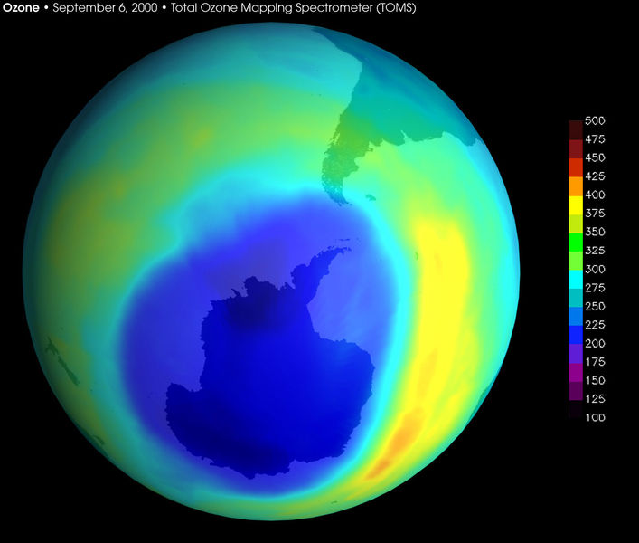
  Why September?
Notes:
Winds and unique cloud chemistry. In September it is the end of their dark winter and the presence of UV takes its effect

Slide 77
Atmospheric Composition
Ionosphere
  Extends from 37 miles (60 km) above the earth's surface to the Thermopause
    Part of Stratosphere, all of Mesosphere & Thermosphere
  Made of electrically charged gas particles (ions).
    Formed when atoms lose one or more electrons as they are bombarded by solar energy

Slide 78
Atmospheric Composition
Ionosphere (Cont.)
  Divided Into Three Layers:
    F-Layer, E-Layer & D-layer.
  Changes In Density From Daytime To Nighttime.
    All three layers are more dense during the daytime.
    At night, all layers decrease in density with the D-Layer undergoing the greatest change.
      At night the D-Layer essentially disappears.

Slide 79
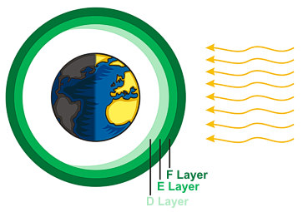

Slide 80
Atmospheric Composition
Ionosphere (Cont.)
  Influences Radio Wave Transmissions
    The ionosphere has the important quality of bouncing radio signals transmitted from the earth.
    Its existence is why places all over the world can be reached via radio.

Slide 81
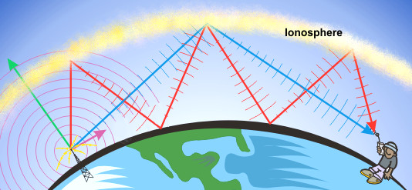
Ionosphere (Cont.)
  Radio Signal Is Transmitted
    Green Arrow
      some of the signal will escape the earth.
    Purple Arrow
      The ground wave is the direct signal we hear on a normal basis.
      This wave weakens quickly and is what one hears as a fading signal.
    Red & Blue Arrows
      Remaining waves bounce off the ionosphere and can bounce for many 1000's of miles.

Slide 82
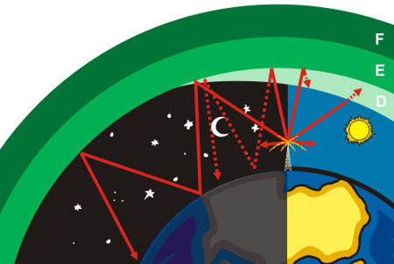
Atmospheric Composition
Daytime
  Distance the AM radio signal travels is based upon the power of the transmitter.
  The D-Layer does not reflect radio signals:
    absorbs them instead.
    Permits more radio stations during the daytime.

Slide 83
Atmospheric Composition
Nighttime
  D-Layer disappears
    signal can bounce off the ionosphere and return to the earth.
  At sunset
    some radio stations must reduce the power of their signal
    Reduces interference with other signals.

Slide 84
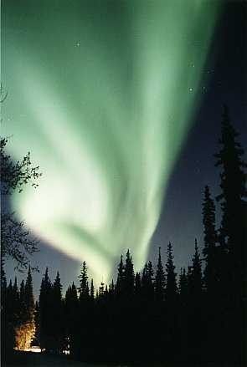
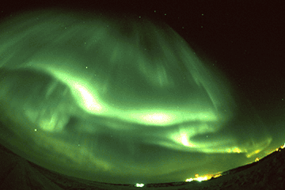
Ionosphere (Cont.)
  Generates Aurora Borealis/Australis
    Borealis (Northern Lights) Australis (Southern Lights)

Slide 85
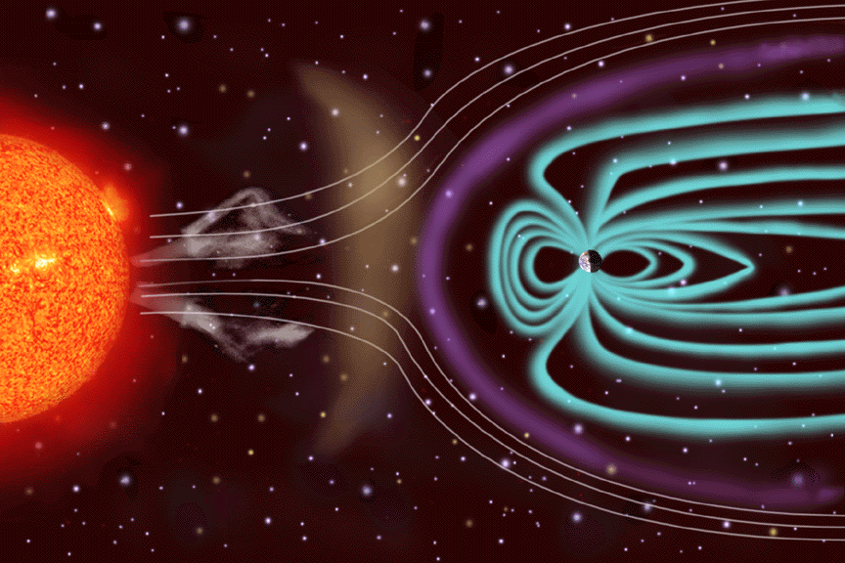
The Sun’s Solar Wind (which contains a stream of subatomic particles) moves extremely fast. It is capable of eroding away planetary atmospheres.
The earth’s atmosphere is protected by the shielding effect of its magnetic field. The same field that makes a compass point north.

Slide 86
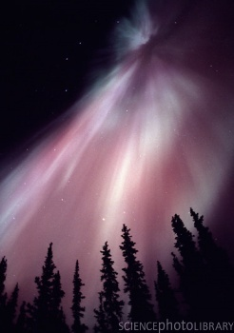
Atmospheric Composition
Ionosphere
  Generates Aurora Borealis/Australis (Cont.)
    However, some subatomic particles are captured by the magnetic field and directed down to the Ionosphere
    This excites the gases in the ionosphere causing them to glow like a neon lamp

Slide 87
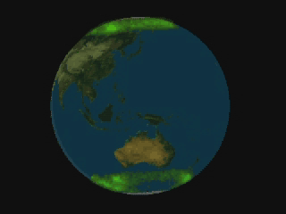

Slide 88
